Slide 1
Leveraging Weather Data to Optimize Energy in New York
Ninja-1: Michelle Armstrong, Appal Badi, David Haddad, Jacob Halsey, Mike Davis
MGMT 59000 – AI-Assisted Big Data Analytics in the Cloud
Purdue University
Professor Chaturvedi
August 16, 2024

Slide 2
Overview
Problem Statement:
The electrical grid in the United States does not have significant energy storage capacity, and there is a cost to transporting and storing fuel for consumption. This creates a cost burden for energy companies that produce too little or too much energy in each time window.
Analysis Objectives:
Improve the precision of energy consumption predictions by integrating real-time weather data into the analysis framework.
Core Goals:
Optimization: Enhance the efficiency of energy production by aligning it more closely with actual demand.
Cost Reduction: Achieve cost savings by minimizing energy waste and ensuring production aligns with consumption needs.
Expected Outcomes:
More reliable energy forecasts can lead to better resource allocation.
Increased ability to manage energy production dynamically, based on real-time weather inputs, leading to a reduction in operational costs.

Slide 3



Methodologies
Combined historical weather and energy consumption data with real-time weather information via a live API.
Data Integration
Assessed the relationship between temperature and energy consumption to identify actionable patterns.
Correlation Analysis
Developed a proof-of-concept model to project energy consumption based on live weather inputs, serving as a foundation for enhancing future prediction accuracy.
Predictive Modeling

Slide 4
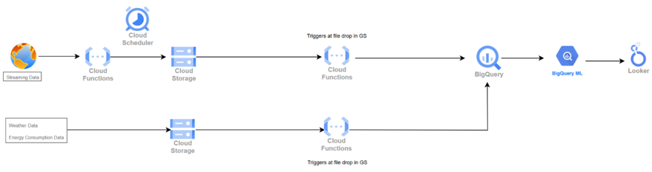
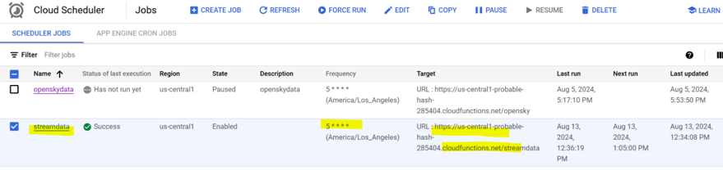
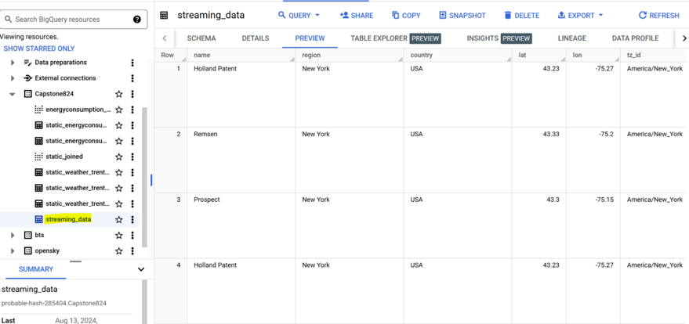
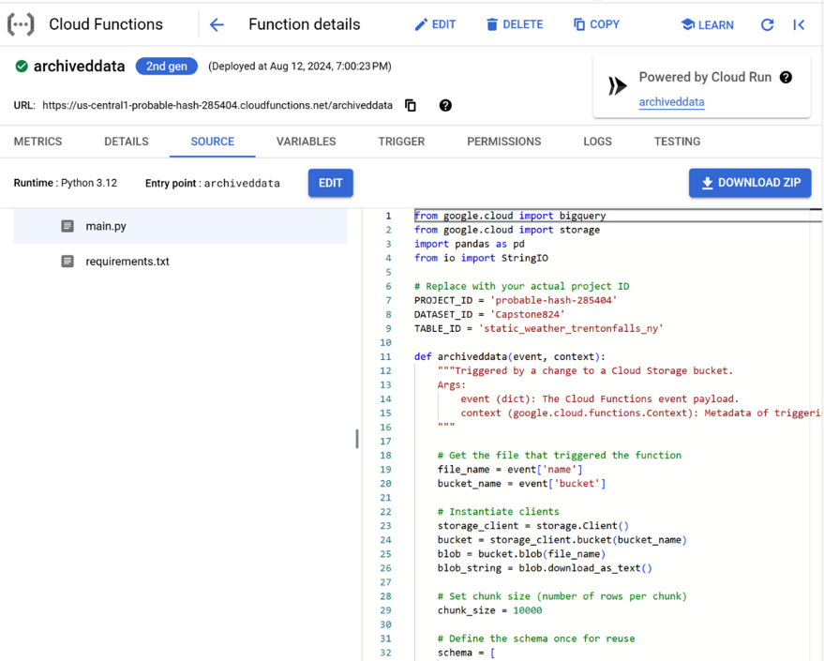
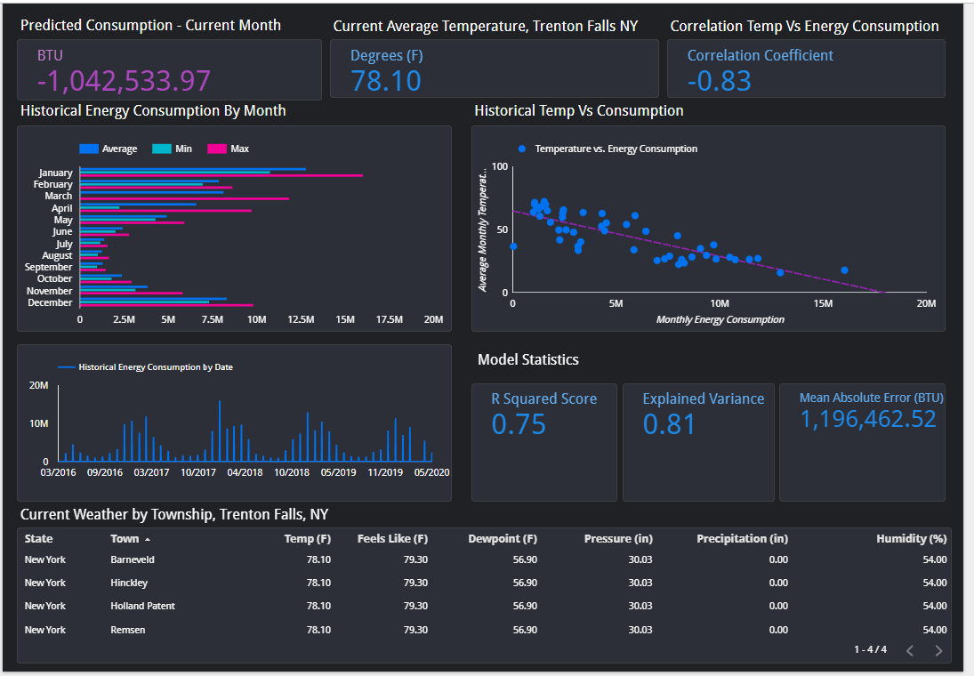
Analysis Examples
Scheduler to Run the API Call Function Every 5 Minutes:
Pipeline
Big Query Table Loading Streaming Data
Cloud Function for a One-Time Load of Data from Cloud Storage to Big Query Table:
Looker Dashboard

Slide 5
Model Findings, Strengths, Limitations, and Recommendations
Key Findings:
Strong, negative correlation (-0.82) between temperature and energy consumption.
Colder months require significantly more energy than cooler months.
Model Strengths:
Temperature is a significant factor in predicting energy usage.
Other prediction models, like those based on cell phone usage, cannot adjust for seasonal factors.
The model has the potential to augment other models, addressing their limitations.
Model Limitations:
Limited tracking of energy below the state level.
Few weather stations keep local temperature records in public data sets.
The model is location-specific and currently tailored to New York’s climate.
Correlation may differ in warmer climates, requiring model adjustments.
More research is necessary to improve and generalize the model.

Slide 6
Recommendations
Recommendations:
Track local weather and energy consumption data more closely.
Expand the model to more locations with available data.
Use the model to augment existing models for maximum accuracy.
Develop an optimization model for utility companies based on the final prediction model.

Slide 7
Resources
Static Data:
Historical Energy Data: https://statics.teams.cdn.office.net/evergreen-assets/safelinks/1/atp-safelinks.html](https://catalog.data.gov/dataset/utility-energy-registry-monthly-zip-code-energy-use-beginning-2016
Historical Weather Data: https://www.climate.gov/maps-data/dataset/past-weather-zip-code-data-table
Live Data
Weather API: https://api.weatherapi.com/v1/current.json?key=7c8218f18550417496b43123242902&q={area}
Competing Models (Cell phone data)
https://epjdatascience.springeropen.com/articles/10.1140/epjds/s13688-016-0075-3#:~:text=An%20accurate%20prediction%20of%20energy,allowing%20an%20efficient%20energy%20storage.
Github Repository Link: https://github.com/jhalsey87/BigData_Capstone824/tree/main
Lookerstudio Dashboard: https://lookerstudio.google.com/u/0/reporting/00b216a9-b9e3-4ba4-a8a1-739f389aefa4/page/KAd8D

